Slide 1
Lecture 2 Loops and conditions
Kristin Privitera-Johnson
FISH 553 Advanced R
School of Aquatic and Fishery Sciences
University of Washington

Slide 2
Programming
Consider the following problem
We have data on age and weights for some animals ("lect2.csv")
The number of data points for each animal is not the same
We want to regress weight on age for each animal
We want to plot the slopes using a histogram
You could do this line by line in a script... painful! Instead devise a part-by-part strategy
Read in the data
For each animal using a loop
Check if there are two or more data points
If yes, regress length on age for that animal
Store the slope
Plot a histogram of the slopes of each regression

Slide 3
Looping
Although vector operations can do many things, and are quick, often we need to repeat things
Loops in R are of this form
for (i in set) {
#do something
}
This is a very flexible structure, try the following:
for (i in seq(from=1,to=5,by=1)) { print(i) }
for (i in 1:100) { print(i) }
for (i in c("1","N","L")) { print(i) }
i is a counter, conventionally we use i, j, k for counters
By far the most common useage

Slide 4
Looping: what is happening?
line 1 for (i in c(1,4,5,8)) {
line 2 print(i)
line 3 }
line 4 print(i)
Step Line Value of i Output
1 1 1
2 2 1 1
3 1 4
4 2 4 4
5 1 5
6 2 5 5
7 1 8
8 2 8 8
9 4 8 8

Slide 5
Looping through species
Imagine we need to calculate the mean petal and sepal lengths for every species in the iris data set
loop.iris <- function (data=iris) {
for (i in unique(data$Species)) {
meanSepalLength <-
mean(data[data$Species==i,]$Sepal.Length)
meanPetalLength <-
mean(data[data$Species==i,]$Petal.Length)
cat(i, meanSepalLength, meanPetalLength, "\n")
}
}
loop.iris()
Pro tip: everything inside the function is indented three spaces, inside the loop by six spaces, allowing reader to easily see which statements are contained within each section of code

Slide 6
Most common way I use loops
species <- sort(unique(iris$Species))
nspecies <- length(species)
mean.lengths <- vector(length=nspecies)
for (i in 1:nspecies) {
species.data <- iris[iris$Species==species[i],]
plot(hist(species.data$Sepal.Length))
mean.lengths[i] <- mean(species.data$Sepal.Length)
print(mean.lengths[i])
cat("Running species ", i,"\n")
}
Species names
How many species
Store answers here
Extract all data for this particular species
Plot the data
Mean sepal length for this species

Slide 7
Function to modify
name of function
arguments of function
sin.period <- function(period) {
xvals <- seq(from=0, to=2*pi, length=100)
yvals <- sin(xvals/period)
plot(x=xvals, y=yvals, type="l", lty=1,
xaxs="i", lwd=2)
}
sin.period(period=1)
start of the function
R commands which can include calls to other functions
end of the function
calling the function
passing values to the function arguments

Slide 8
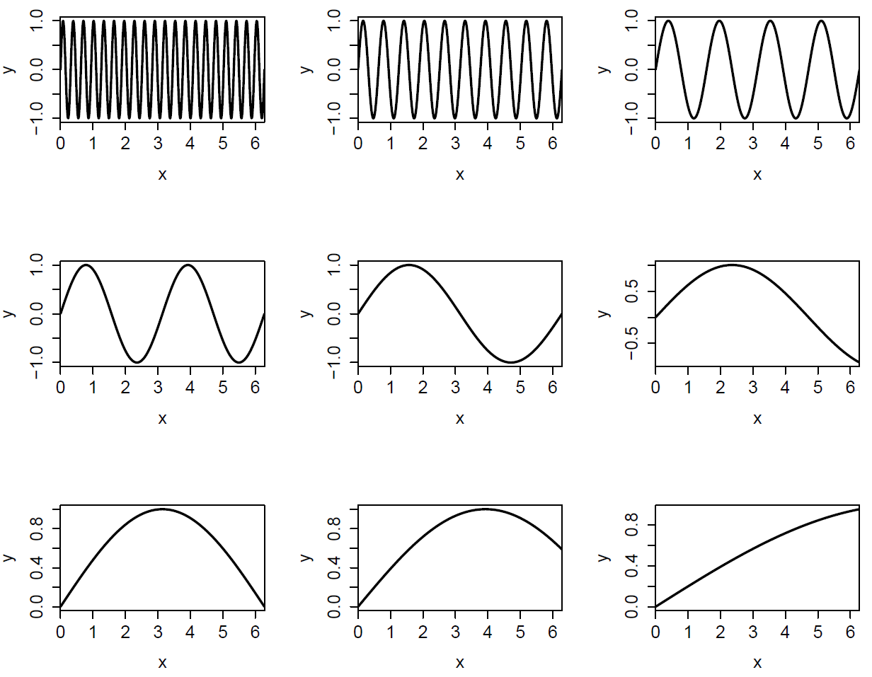

Slide 9
The while-loop
The while-loop is rarely used because the for-loop can almost always be used for looping
But occasionally we don’t know how many times to execute the loop
In such cases we use a while loop, which executes a series of statements for as long as some condition remains true
The general syntax is
while (condition) {
#statements
}

Slide 10
While-loop example
If there are 10,000 polar bears in year 2015 and they are declining at 9% per year, in what year will they fall below 500 individuals?
polar.loop <- function(N, year=2015) {
while (N>500) {
N <- N*0.91
year <- year+1
}
return(year)
}
> polar.loop(N=10000)
[1] 2047
Pro-tip: when you end up in an infinite loop with no stopping point, press <ESC> to stop it running!

Slide 11
The apply functions are special loops
We’ve already seen similar behavior as loops when we used tapply and apply.
This function loops through unique things (rows, columns, groups, ..) and returns something for each.
In general, use apply functions where possible as they tend to be faster, easier to read, don’t require or produce global variables
sapply is even more like a for loop:
x1 <- sapply(1:3, print)
x1
x2 <- sapply(1:3, function(i) {i^2})
x2

Slide 12
If statements
Often we need to check that our data are correct before proceeding with an analysis, for example we could not plot x and y if their lengths were different
plotxy <- function(x, y) {
if (length(x) == length(y)) {
plot(x,y)
}
else {
print("Lengths of x and y are different")
}
}
> plotxy(x=1:5, y=5:1)
> plotxy(x=1:5, y=4:1)
[1] "Lengths of x and y are different"

Slide 13
Generic if statement
The generic if-statement is:
if (condition) {
#statements
}
Also possible to do an “else” and “if else” construct
if (condition1) {
#statements1
} else if (condition2){
#statements2
} else {
#statements3
}
Only executes #statements if condition is TRUE
Breaks after running statements for a TRUE condition. Last “else” has no condition so always runs if nothing before it was TRUE

Slide 14
Conditions
Conditions in an if-statement are based on Boolean operators (must evaluate to TRUE or FALSE)
== Boolean equals (don’t use =)
!=, >=, <=, >, < , | &
Common conditions in if-statements
if (x==5)
if (x==5 & y==7)
if (x==5 | y>=17)
if (x %in% c(1,2,3,5))
if (!found)
if (!is.na(x) & y==3)

Slide 15
Complicated if-then-else statements
sum.bigger <- function(x, y) {
if(length(x) != length(y)) {
print("not equal lengths")
}
else {
if (sum(x) > sum(y)) {
print("x bigger")
}
else {
print("x smaller or equal")
}
}
}
> sum.bigger(x=1:5, y=6:10)
[1] "x smaller or equal"
Calling an if-then-else statement within an if-then-else statement. Line indentation is critical!

Slide 16
Switch statement
Sometimes you might find yourself writing a multiple “nested” if statement
For example, if x==1 then do something, else if x==2 then do something, else if x==3 then do a third thing, else if x==4 then do a fourth thing...
Instead, use a switch statement
This evaluates the first parameter, and does different things depending on its value
Switch statements are rarely used but very useful when needed

Slide 17
Switch statement: text values
require(stats)
centre <- function(x, type) {
return(switch(type,
mean = mean(x),
median = median(x),
trimmed = mean(x, trim = .1),
"No function matches") )
}
> x <- rcauchy(10)
> centre(x, "mean")
[1] 0.09228939
> centre(x, "median")
[1] -0.4580926
> centre(x, "unknown")
[1] "No elements match"
This is like writing:
if (type=="mean") {
temp <- mean(x)
} else if (type=="median") {
temp <- median(x)
} else if (type=="trimmed") {
temp <- mean(x, trim=.1)
} else {
temp <- "No function matches"
}
return(temp)

Slide 18
Switch statement: number values
alternatives <- function(x, value) {
return(switch(value,
"You chose option 1",
x^3,
"Option 3") )
}
> alternatives(x=3,value=1)
[1] "You chose option 1"
> alternatives(x=3,value=2)
[1] 27
> alternatives(x=3,value=3)
[1] "Option 3"
For numbers, it returns the argument of switch after the value

